Slide 1
User Churn with
Warby Parker
Analyze Data with SQL
Vlad Chuvardynskyi
05.15.2023

Slide 2
Table of Contents
Task 1. Inspect subscriptions table
Task 2. Determine the time horizon of data
Task 3. Create months table
Task 4. Create cross_join table
Task 5. Create status table
Task 6. Track cancellations in segments
Task 7. Create status_aggregate table
Task 8. Calculate the churn rates

Slide 3
About company
The Codeflix is an Australian online video streaming service for kids providing fun, engaging and educational videos on the most popular coding, robotics and digital technologies topics. The online platform offers pedagogical video tutorials, covering a range of coding languages and activities for kids of various ages and experience levels.

Slide 4
Marketing funnels and purpose:
Purpose: During this project we will analyze Codeflix database in order to calculate subscription churn rates between two segments of users.
Given: The dataset provided to us is containing subscription data for users who were acquired through two distinct channels, and it grouped into one SQL table named "subscriptions".
The given SQL table includes the following columns:
1. 'id’ - the subscription id
2. 'subscription_start’ - the start date of the subscription
3. 'subscription_end' - the end date of the subscription
4. 'segment’ - this identifies which segment the subscription owner belongs to

Slide 5
Task 1. Inspect subscriptions table

Slide 6
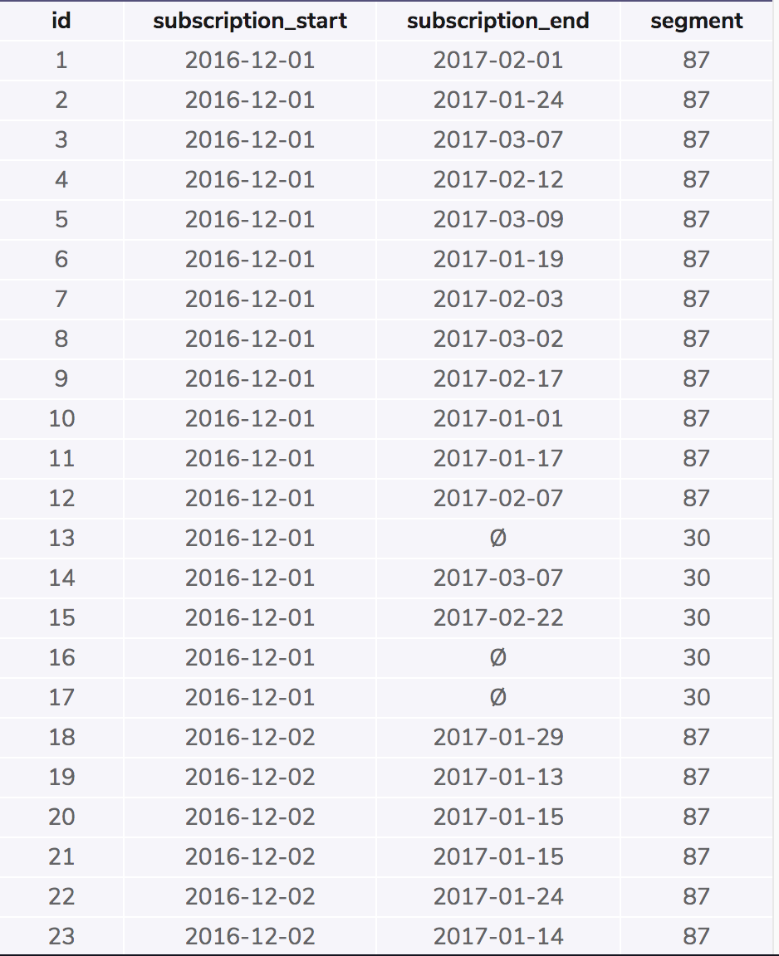
1. Inspecting the first 100 rows of subscriptions table
How many segments do you see?
The table "subscriptions" presents the only 2 segments (87 and 30) where the company is operating
SELECT *
FROM subscriptions
LIMIT 100;

Slide 7
Task 2. Determine the time horizon of data

Slide 8
2. Determine the time horizon of data provided
The company has been operating 4 months, starting from December 2016 to March 2017
The table ‘subscription’ provides enough information to calculate the churn rate for January, February and March months
*(Not from December 2016 to March 2017 because cancellation are not allowed during the first 31 days of first subscription in December 2016)
SELECT MIN(subscription_start),
MAX(subscription_end)
FROM subscriptions;

Slide 9
Task 3. Create months table

Slide 10
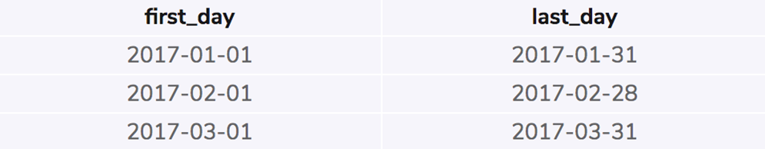
3. Create a temporary table called months
Temporary table: months
Months table shows the first and last day of each month during the time horizon of months for which we are analyzing the churn rates.
We underline the first and last day for January, February and March months
WITH months AS(
SELECT
'2017-01-01' AS first_day,
'2017-01-31' AS last_day
UNION
SELECT
'2017-02-01' AS first_day,
'2017-02-28' AS last_day
UNION
SELECT
'2017-03-01' AS first_day,
'2017-03-31' AS last_day
)
SELECT *
FROM months;

Slide 11
Task 4. Create cross_join table

Slide 12
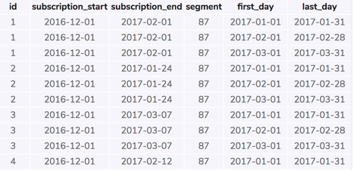
4. Create a temporary table called cross_join
Create a temporary table “cross_join” from “subscription” and “months” in order to see monthly subscription information of users
Selecting every column from “cross_join” table
WITH months AS(
SELECT
'2017-01-01' AS first_day,
'2017-01-31' AS last_day
UNION
SELECT
'2017-02-01' AS first_day,
'2017-02-28' AS last_day
UNION
SELECT
'2017-03-01' AS first_day,
'2017-03-31' AS last_day
),
cross_join AS(
SELECT *
FROM subscriptions
CROSS JOIN months
)
SELECT *
FROM cross_join;

Slide 13
Task 5. Create status table

Slide 14
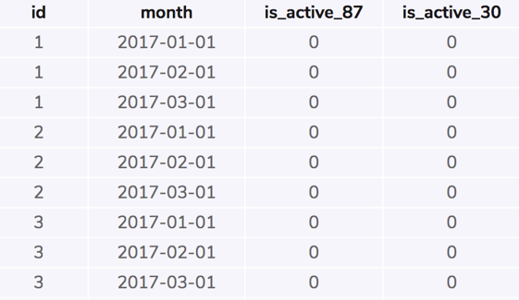
5. Create a temporary table called status
Create a temporary table “status” to show the active status of users’ subscription information by “30” & “87” segments and months
Selecting every column from “status” table that represents active (1) subscription status for certain user (id) corresponding to underlying month (month)
WITH months AS(
SELECT
'2017-01-01' AS first_day,
'2017-01-31' AS last_day
UNION
SELECT
'2017-02-01' AS first_day,
'2017-02-28' AS last_day
UNION
SELECT
'2017-03-01' AS first_day,
'2017-03-31' AS last_day
),
cross_join AS(
SELECT *
FROM subscriptions
CROSS JOIN months
),
status AS (
SELECT id,
first_day AS month,
CASE
WHEN (subscription_start > first_day)
AND segment = 87
AND (
subscription_end > first_day
OR subscription_end IS NULL
) THEN 1
ELSE 0
END AS is_active_87,
CASE
WHEN(subscription_start > first_day)
AND segment = 30
AND (
subscription_end > first_day
OR subscription_end IS NULL
) THEN 1
ELSE 0
END AS is_active_30
FROM cross_join
)
SELECT *
FROM status;

Slide 15
Task 6. Track cancellations in segments

Slide 16

6. Track cancellations in segments
Create a temporary table “status” to show both active and canclled status of users’ subscription information by “30” & “87” segments and months
Selecting every column from “status” table that represents active (1) and cancelled (0) subscription status for certain user (id) corresponding to underlying month (month)
WITH months AS(
SELECT
'2017-01-01' AS first_day,
'2017-01-31' AS last_day
UNION
SELECT
'2017-02-01' AS first_day,
'2017-02-28' AS last_day
UNION
SELECT
'2017-03-01' AS first_day,
'2017-03-31' AS last_day
),
cross_join AS(
SELECT *
FROM subscriptions
CROSS JOIN months
),
status AS (
SELECT id,
first_day AS month,
CASE
WHEN (subscription_start > first_day)
AND segment = 87
AND (
subscription_end > first_day
OR subscription_end IS NULL
) THEN 1
ELSE 0
END AS is_active_87,
CASE
WHEN(subscription_start > first_day)
AND segment = 30
AND (
subscription_end > first_day
OR subscription_end IS NULL
) THEN 1
ELSE 0
END AS is_active_30,
CASE
WHEN (subscription_end BETWEEN first_day AND last_day) AND (segment = 87) THEN 1
ELSE 0
END AS is_canceled_87,
CASE
WHEN (subscription_end BETWEEN first_day AND last_day) AND (segment = 30) THEN 1
ELSE 0
END AS is_canceled_30
FROM cross_join
)
SELECT *
FROM status;

Slide 17
Task 7. Create status_aggregate table

Slide 18
7. Create status_aggregate table
WITH months AS(
SELECT
'2017-01-01' AS first_day,
'2017-01-31' AS last_day
UNION
SELECT
'2017-02-01' AS first_day,
'2017-02-28' AS last_day
UNION
SELECT
'2017-03-01' AS first_day,
'2017-03-31' AS last_day
),
cross_join AS(
SELECT *
FROM subscriptions
CROSS JOIN months
),
status AS (
SELECT id,
first_day AS month,
CASE
WHEN (subscription_start > first_day)
AND segment = 87
AND (subscription_end > first_day
OR subscription_end IS NULL
) THEN 1
ELSE 0
END AS is_active_87,
CASE
WHEN(subscription_start > first_day)
AND segment = 30
AND (
subscription_end > first_day
OR subscription_end IS NULL
) THEN 1
ELSE 0
END AS is_active_30,
CASE
WHEN (subscription_end BETWEEN first_day AND last_day) AND (segment = 87) THEN 1
ELSE 0
END AS is_canceled_87,
CASE
WHEN (subscription_end BETWEEN first_day AND last_day) AND (segment = 30) THEN 1
ELSE 0
END AS is_canceled_30
FROM cross_join
),
status_aggregate AS (
SELECT
month,
SUM(is_active_87) AS sum_active_87,
SUM(is_active_30) AS sum_active_30,
SUM(is_canceled_87) AS sum_canceled_87,
SUM(is_canceled_30) AS sum_canceled_30
FROM status
GROUP BY 1)
SELECT *
FROM status_aggregate;

Slide 19
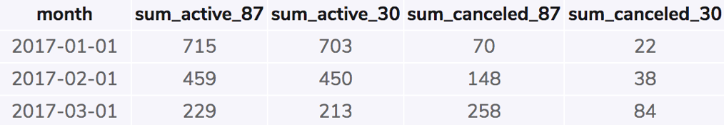
7. Create status_aggregate table
Status_aggregate table adds up the status of active and cancelled users for each segment to provide an overall total for each month.
Task: Codeflix should check why so many users are cancelling over time in segment 87. They can survey the users to analyze pain points (such as system errors) and try to fix them. They can also offer more incentives to continue the subscription for users.
Sum up number of both active and cancelled subscriptions for each segment ,and each month
Column called: sum_active_87, sum_active_30, sum_canceled_87, sum_canceled_30
The query for creating status_aggregate temporary table is presented on the previous slide

Slide 20
Task 8. Calculate the churn rates

Slide 21
8.1. Calculate the churn rates for the two segments over the three-month time period
WITH months AS(
SELECT
'2017-01-01' AS first_day,
'2017-01-31' AS last_day
UNION
SELECT
'2017-02-01' AS first_day,
'2017-02-28' AS last_day
UNION
SELECT
'2017-03-01' AS first_day,
'2017-03-31' AS last_day
),
cross_join AS(
SELECT *
FROM subscriptions
CROSS JOIN months
),
status AS (
SELECT id,
first_day AS month,
CASE
WHEN (subscription_start > first_day)
AND segment = 87
AND (subscription_end > first_day
OR subscription_end IS NULL
) THEN 1
ELSE 0
END AS is_active_87,
CASE
WHEN(subscription_start > first_day)
AND segment = 30
AND (
subscription_end > first_day
OR subscription_end IS NULL
) THEN 1
ELSE 0
END AS is_active_30,
CASE
WHEN (subscription_end BETWEEN first_day AND last_day) AND (segment = 87) THEN 1
ELSE 0
END AS is_canceled_87,
CASE
WHEN (subscription_end BETWEEN first_day AND last_day) AND (segment = 30) THEN 1
ELSE 0
END AS is_canceled_30
FROM cross_join
),
status_aggregate AS (
SELECT
month,
SUM(is_active_87) AS sum_active_87,
SUM(is_active_30) AS sum_active_30,
SUM(is_canceled_87) AS sum_canceled_87,
SUM(is_canceled_30) AS sum_canceled_30
FROM status
GROUP BY 1)
SELECT
month,
1.0 * sum_canceled_87 / sum_active_87 AS churn_rate_87,
1.0 * sum_canceled_30 / sum_active_30 AS churn_rate_30
FROM status_aggregate;

Slide 22
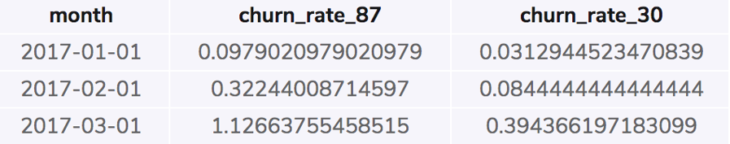
8.1. Calculate the churn rates for the two segments over the three-month time period
The query for creating status_aggregate temporary table calculating churn rates are presented on the previous slide
Codeflix had the highest cancellation rate of 1.13% for user subscriptions in segment 87 during March.

Slide 23
8.2. Which segment has a lower churn rate?
WITH months AS(
SELECT
'2017-01-01' AS first_day,
'2017-01-31' AS last_day
UNION
SELECT
'2017-02-01' AS first_day,
'2017-02-28' AS last_day
UNION
SELECT
'2017-03-01' AS first_day,
'2017-03-31' AS last_day
),
cross_join AS(
SELECT *
FROM subscriptions
CROSS JOIN months
),
status AS (
SELECT id,
first_day AS month,
CASE
WHEN (subscription_start > first_day)
AND segment = 87
AND (subscription_end > first_day
OR subscription_end IS NULL
) THEN 1
ELSE 0
END AS is_active_87,
CASE
WHEN(subscription_start > first_day)
AND segment = 30
AND (
subscription_end > first_day
OR subscription_end IS NULL
) THEN 1
ELSE 0
END AS is_active_30,
CASE
WHEN (subscription_end BETWEEN first_day AND last_day) AND (segment = 87) THEN 1
ELSE 0
END AS is_canceled_87,
CASE
WHEN (subscription_end BETWEEN first_day AND last_day) AND (segment = 30) THEN 1
ELSE 0
END AS is_canceled_30
FROM cross_join
),
status_aggregate AS (
SELECT
month,
SUM(is_active_87) AS sum_active_87,
SUM(is_active_30) AS sum_active_30,
SUM(is_canceled_87) AS sum_canceled_87,
SUM(is_canceled_30) AS sum_canceled_30
FROM status
GROUP BY 1),
churn_rate_summary AS (
SELECT
month,
1.0 * sum_canceled_87 / sum_active_87 AS churn_rate_87,
1.0 * sum_canceled_30 / sum_active_30 AS churn_rate_30
FROM status_aggregate)
SELECT
SUM(churn_rate_87) AS churn_rate_87_total,
SUM(churn_rate_30) AS churn_rate_30_total
FROM churn_rate_summary;

Slide 24
8.2. Which segment has a lower churn rate?
The query for creating status_aggregate temporary table calculating churn rates are presented on the previous slide
Resume: the segment 30 has a lower churn rate (~0,51%) in comparison to segment 87 (~1,54%)
Codeflix company should investigate the sources of customer’s satisfaction in segment 30, trying to underline some patterns and imply them to segment 87 for decreasing the number of cancellations during the subscription period.

